Slide 1
PROJECT TITLE :- PSCS_352 Development of AI-ML based models for predicting prices of Agri-horticultural commodities such as pulses and vegetable (onion, potato)
PIP 4004 University Project
Review-0
Batch Number: CIT-G12
Student Name | Roll Number
Thanu Shree M | 20211CIT0034
Ananya B R | 20221LIN0002
Rohan Gowda A | 20221LIN0003
Puneeth N | 20221LIN0004
Ajin V Joseph | 20221LIN0007
Under the Supervision of,
Dr Shanthi S
Associate Professor
School of Computer Science and Engineering
Presidency University
Name of the Program: Btech CSE(IoT)
Name of the HoD: Dr. Anandaraj S P
Name of the Program Project Coordinator: Dr. Sharmasth Vali Y
Name of the School Project Coordinators: Dr. Sampath A K / Dr. Abdul Khadar A / Mr. Md Ziaur Rahman

Slide 2
Content
Problem Statement
Analysis of Problem Statement
Timeline of the Project
References

Slide 3
Problem Statement Number: PSCS 352
Organization: Ministry of Culture
Category (Hardware / Software / Both) :Software
Problem Description : The Department of Consumer Affairs monitors the daily prices of 22 essential food commodities through 550 price reporting centers across the country. The Department also maintains buffer stock of pulses, viz., gram, tur, urad, moon and masur, and onion for strategic market interventions to stabilize the volatility in prices. Decisions for market interventions such as release of stocks from the buffer are taken on the basis of the price trends and outlook. At present, the analyses of prices are based on the seasonality, historical and emerging trends, market intelligence inputs, crop sowing and production estimates. ARIMA based economic models have also been used to examine and forecast prices of pulses.

Slide 4
Analysis of Problem Statement
Introduction
Agriculture is a crucial sector in many economies.
Price fluctuations of agri-horticultural commodities affect farmers, traders, and consumers.
AI-ML techniques can help in accurate price prediction, enabling better decision-making.
Problem Statement
Prices of commodities like onions, potatoes, and pulses fluctuate due to multiple factors.
Farmers and traders face challenges in determining the right time to sell or buy.
Traditional methods of price prediction are inefficient and lack accuracy.
Need for AI-ML-based models for better price forecasting.

Slide 5
Analysis of Problem Statement (contd...)
Factors Affecting Prices
Weather conditions (rainfall, temperature, droughts)
Supply chain disruptions
Demand fluctuations
Government policies and subsidies
Market trends and seasonal variations
Data Collection
Sources of data:
Government websites (e.g., Agmark net, FAO, APEDA)
Market price APIs
Historical price datasets
Weather databases
Data preprocessing steps:
Handling missing values
Feature extraction
Normalization and scaling

Slide 6
Analysis of Problem Statement (contd...)
Machine Learning Models for Price Prediction
Time Series Models:
ARIMA (Auto-Regressive Integrated Moving Average)
LSTM (Long Short-Term Memory Neural Networks)
Facebook Prophet
Regression Models:
Linear Regression
Random Forest Regressor
XG Boost
Hybrid Models:
Combination of time-series forecasting and ML techniques

Slide 7
Analysis of Problem Statement (contd...)
Model Selection & Training
Comparison of models based on:
Accuracy
Computational efficiency
Interpretability
Splitting data into training and testing sets

Slide 8
Analysis of Problem Statement (contd...)
Expected Outcomes
Improved price prediction accuracy
Better decision-making for farmers and traders
Reduced risks associated with price fluctuations
Insights into market trends and future demands
Challenges & Future Scope
Challenges:
Data availability and quality
External factors affecting predictions (natural calamities, policy changes)
Model interpretability and deployment issues
Future Scope:
Integration with IoT and satellite data
Real-time forecasting systems
AI-powered market advisory tools

Slide 9
Analysis of Problem Statement (contd...)
Conclusion
AI-ML-based models can significantly enhance price forecasting for agricultural commodities.
Improved decision-making for stakeholders.
Future advancements can make predictions even more reliable and accessible.

Slide 10
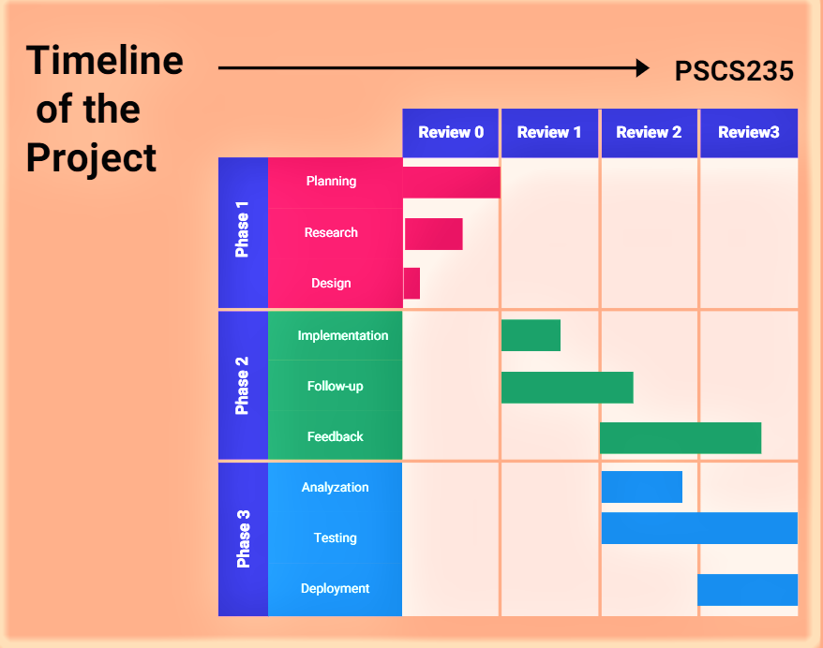
Timeline of the Project (Gantt Chart)
PSCS_353

Slide 11
References (IEEE Paper format)
https://r.search.yahoo.com/_ylt=Awrx.dmKfqFnCAIA.AO7HAx.;_ylu=Y29sbwNzZzMEcG9zAzEEdnRpZAMEc2VjA3Ny/RV=2/RE=1739846539/RO=10/RU=https%3a%2f%2fijettjournal.org%2fVolume-71%2fIssue-12%2fIJETT-V71I12P226.pdf/RK=2/RS=FEOqP4uq7O9sx8kWD_TozERZCKE-
https://r.search.yahoo.com/_ylt=Awrx.dmKfqFnCAIACgS7HAx.;_ylu=Y29sbwNzZzMEcG9zAzcEdnRpZAMEc2VjA3Ny/RV=2/RE=1739846539/RO=10/RU=https%3a%2f%2farxiv.org%2fabs%2f2310.18646/RK=2/RS=Qy4o2RfQ_4hQv1VRmbJ6t_xtNOo-
https://github.com/Puneetn21/PIP_4004_CIT_G12 (GitHub repository)

Slide 12


